Slide 1
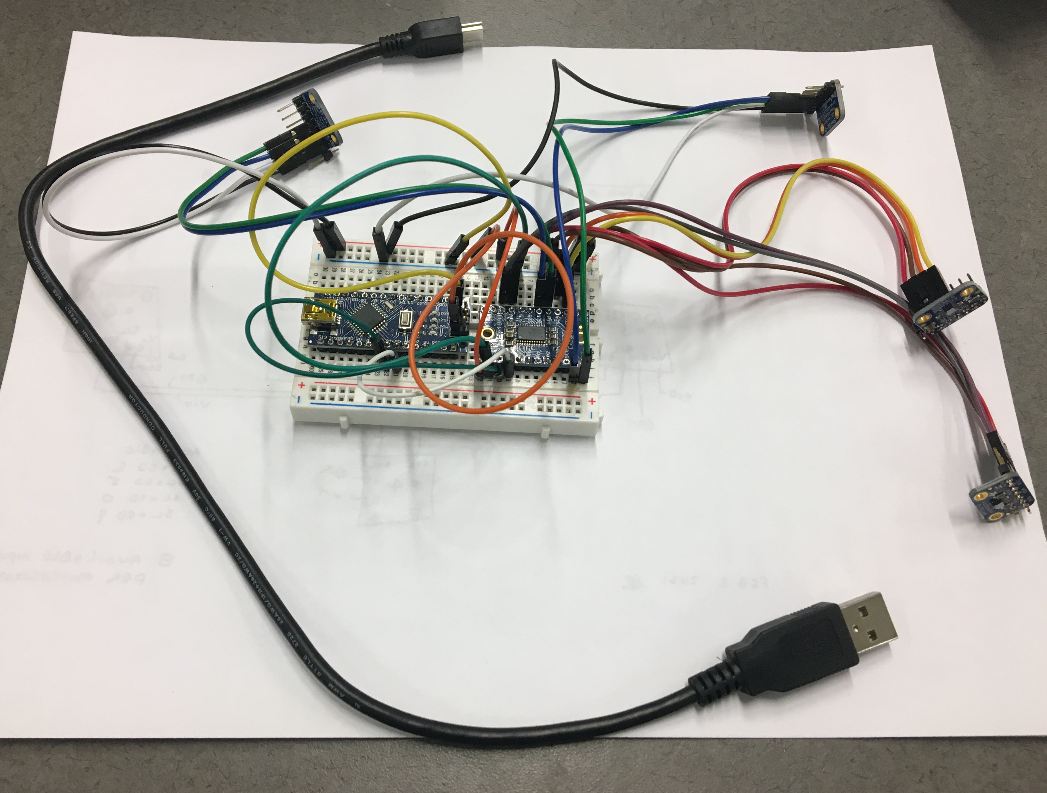
Overview
Arduino
Multiplexer
Sensor

Slide 2
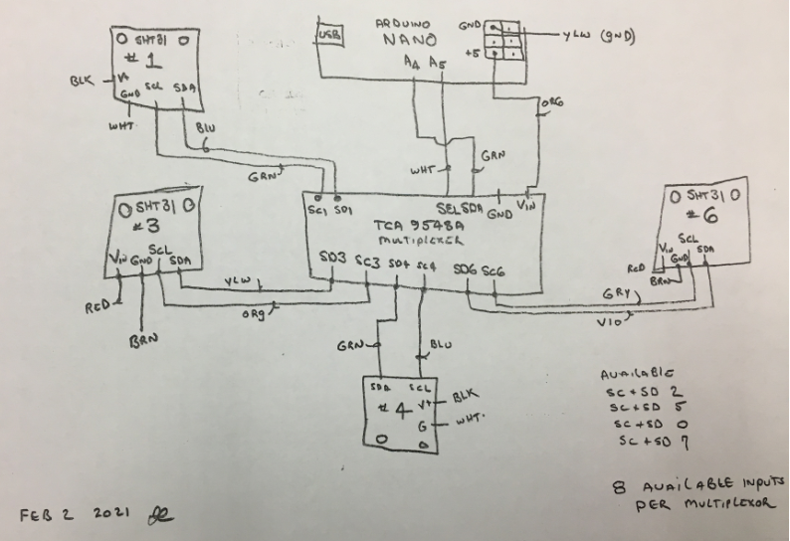
Circuit Diagram

Slide 3
Bridge Inspection Guidelines
Item | Part No. | Unit price ($)
ADA fruit multiplexer | TCA 9548A | 6.95
ADA fruit temp. and hum. sensor | SHT 31-D | 13.95
ADA fruit extension jumper (40×6) | #826 | 3.95
Arduino Nano V.3 with USB cable |  | 13.95

